Slide 1
Azure Databricks Overview
Daniel Wang
Cloud Solutions Architect

Slide 2
Azure Databricks
Databricks Spark as a managed service on Azure

Slide 3





POSITIONING THE DIFFERENT BIG DATA SOLUTIONS
KNOWING THE VARIOUS BIG DATA SOLUTIONS
CONTROL
EASE OF USE
Azure Data Lake
Analytics
Data Engineering in a
Job-as-a-service model
Azure Databricks
Frictionless & Optimized Spark clusters
Azure HDInsight
Workload optimized, managed clusters
Reduced Administration
Azure Marketplace
HDP | CDH | MapR
Any Hadoop technology, any distribution
BIG DATA
ANALYTICS
IaaS Clusters
Managed Clusters
Big Data as-a-service
Azure Data Lake Analytics
Azure Data Lake Store
BIG DATA STORAGE
Azure Storage

Slide 4
Apache Spark
An unified, open source, parallel, data processing framework for Big Data Analytics
Spark SQL
Interactive
Queries
Spark MLlib
Machine
Learning
Spark
Streaming
Stream processing
GraphX
Graph
Computation
  Spark Unifies:
  Batch Processing
  Interactive SQL
  Real-time processing
  Machine Learning
  Deep Learning
  Graph Processing
Spark Core Engine
Yarn
Mesos
Standalone Scheduler
Spark MLlib
Machine
Learning
Spark Structured
Streaming
Stream processing

Slide 5
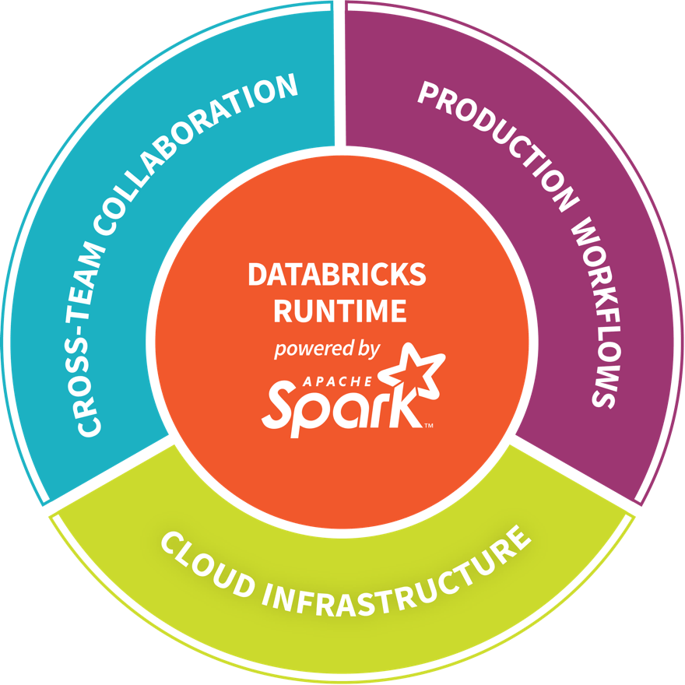
Databricks - Company Overview
  Founded in late 2013
  By the creators of Apache Spark, original team from UC Berkeley AMPLab
  Largest code contributor code to Apache Spark
  Level 2/3 support partnership with
      Hortonworks
      MapR
      DataStax
  Provides certifications such as Databricks Certified Application, Databricks Certified Distribution and Databricks Certified Developer
  Main Product: The Unified Analytics Platform
  In Oct 2017, introduced Databricks Delta (currently in private preview).

Slide 6



Azure Databricks
Azure Databricks
Collaborative Workspace
IoT / streaming data
Machine learning models
DATA ENGINEER
DATA SCIENTIST
BUSINESS ANALYST
Deploy Production Jobs & Workflows
Cloud storage
BI tools
MULTI-STAGE PIPELINES
JOB SCHEDULER
NOTIFICATION & LOGS
Data warehouses
Optimized Databricks Runtime Engine
Data exports
Hadoop storage
DATABRICKS I/O
APACHE SPARK
SERVERLESS
Rest APIs
Data warehouses
Enhance Productivity
Build on secure & trusted cloud
Scale without limits
Notes:
Databricks, founded by the team that created Apache Spark – unified analytics platform that accelerates innovation by unifying data science, engineering & business.
75% of the code committed to Apache Spark comes from Databricks
Unified Runtime
Create clusters in seconds, dynamically scale them up and down.
They’ve made enhancements to Spark engine to make it 10x faster than open source Spark
Serverless- Auto-configured multi-user cluster, Reliable sharing with fault isolation
Unified Collaboration
Overall – a simple & collaborative environment that enables your entire team to use Spark & interact with your data simultaneously
DE – Improve ETL performance, zero management clusters. Execute production code from within notebooks
DS - For data scientists, easy data exploration in notebooks
Business SME – interactive dashboards empower teams to create dynamic reports
Enterprise Security
Encryption
Fine grained Role-based access control (files, clusters, code, application, dashboard)
Compliance
Rest APIs
DE – DBIO, SPARK, API’s , JOBS
DS – Spark and Serverless, Interactive Data Science
Data Products - Everything
Creators of Spark
Training People
Number of Customers
Ingest
Workflow
Schedule / Run / Monitor
Execute
Troubleshoot
Debug
Production Jobs
---------
Ingest, ETL, Scheduling, Monitoring

Slide 7





Azure Databricks Core ARTIFACTS
Clusters
Libraries
Workspaces
Azure Databricks
Jobs
Notebooks

Slide 8


Azure Databricks Cluster architecture
Spark History Server
Webapp
Log Daemon
Azure Compute
Spark Worker
Azure Compute
Azure DB for PostgreSQL
Spark Driver
Azure Compute
FileSystem
Service
Jobs
Cluster Manager
Azure Compute
Spark Worker
Log Daemon
Databricks’ Azure Account
User’s Azure Account
Resource in the Databricks’ account are not visible to users

Slide 9
General Spark Cluster Architecture
Driver Program
SparkContext
  ‘Driver’ runs the user’s ‘main’ function and executes the various parallel operations on the worker nodes.
  The results of the operations are collected by the driver
  The worker nodes read and write data from/to Data Sources including HDFS.
  Worker node also cache transformed data in memory as RDDs (Resilient Data Sets).
  Worker nodes and the Driver Node execute as VMs in public clouds (AWS, Google and Azure).
Cluster Manager
Worker Node
Worker Node
Worker Node
Cache
Cache
Cache
Task
Task
Task
Data Sources (HDFS, SQL, NoSQL, …)

Slide 10
Azure Databricks
Core Concepts

Slide 11
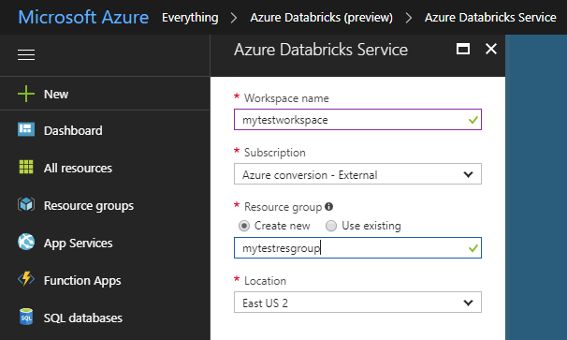
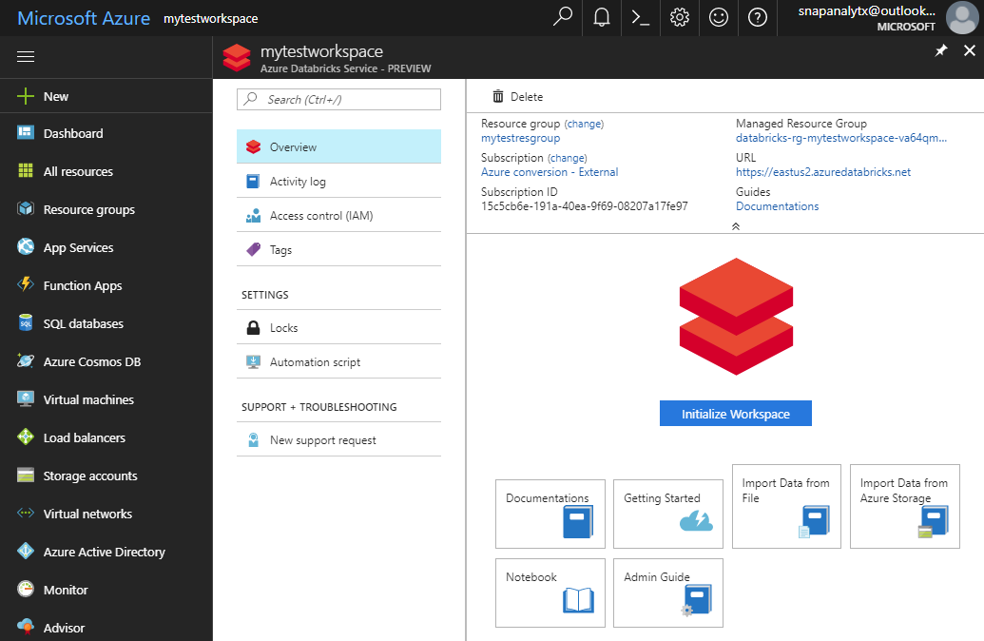
Provisioning Azure Databricks WORKSPACE
  Azure Databricks is provisioned directly from the Azure Portal like any other Azure service
    In contrast, with other clouds, it has to be provisioned through the Databricks portal.
    With Azure Databricks, the Azure Portal offers a unified portal to provision and administer Azure Databricks as well as other Azure services.
  Any Azure user with the appropriate subscription and authorization can provision Azure Databricks service*.
    There is no need for a separate Databricks account
Provisioning the Azure Databricks Service
After provisioning the is complete
    * During the current preview phase, the subscription has to be whitelisted.
Notes:
It is possible for a non-Azure user to access the Databricks cluster through a public URL. Such users have limited rights.

Slide 12
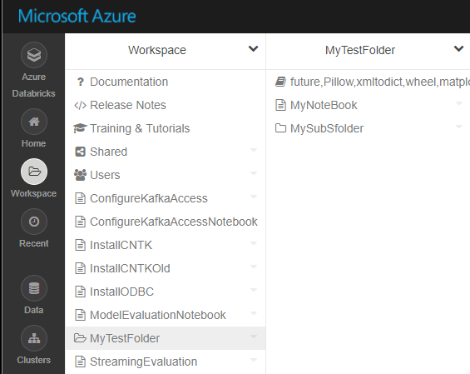
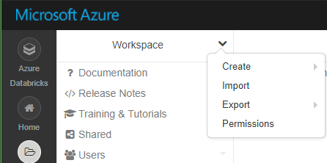

Workspaces
Workspaces enables users to organize—and share—their Notebooks, Libraries and Dashboards
  Workspaces—sort of like Directories— are a convenient way to organize a user’s Notebook, Libraries and Dashboards.
  Everything in a workspace is organized into hierarchical folders. Folders can hold Libraries, Notebooks, Dashboard or more (sub) folders.
    Icons indicate the type of the object contained in a folder
  Every user has one directory that is private and unshared.
    By default, the workspace and all its contents are available to users.
  Fine grained access control can be defined on workspaces to enable secure collaboration with colleagues.

Slide 13
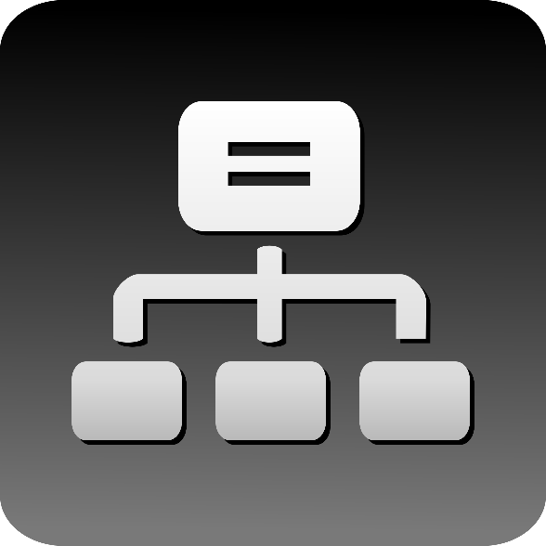
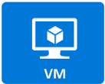
Clusters
  Azure Databricks clusters are the set of Azure Linux VMs that host the Spark Worker and Driver Nodes
  Your Spark application code (i.e. Jobs) runs on the provisioned clusters.
  Azure Databricks clusters are launched in your subscription—but are managed through the Azure Databricks portal.
  Azure Databricks provides a comprehensive set of graphical wizards to manage the complete lifecycle of clusters—from creation to termination.

Slide 14
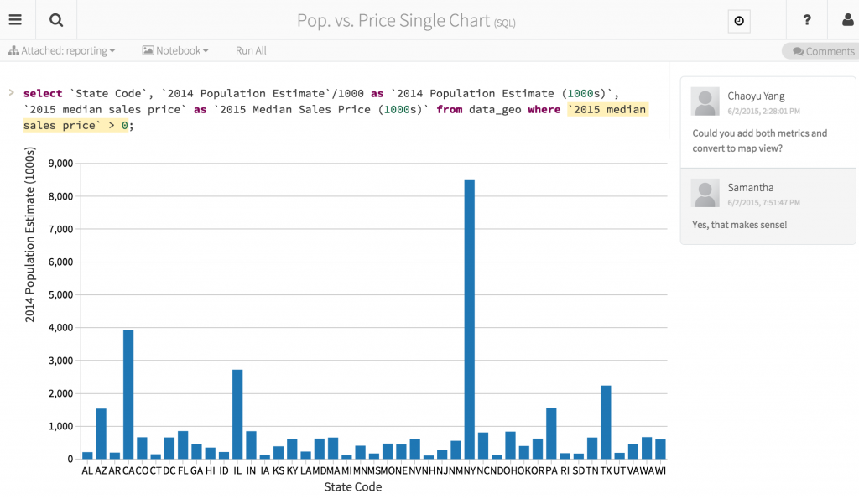
Azure Databricks Notebooks Overview
Notebooks are a popular way to develop, and run, Spark Applications
  Notebooks are not only for authoring Spark applications but can be run/executed directly on clusters
    Shift+Enter
    click the at the top right of the cell in a notebook
    Submit via Job
  Notebooks support fine grained permissions—so they can be securely shared with colleagues for collaboration (see following slide for details on permissions and abilities)
  Notebooks are well-suited for prototyping, rapid development, exploration, discovery and iterative development
  Notebooks typically consist of code, data, visualization, comments and notes

Slide 15

Jobs
Jobs are the mechanism to submit Spark application code for execution on the Databricks clusters
  Spark application code is submitted as a ‘Job’ for execution on Azure Databricks clusters
  Jobs execute either ‘Notebooks’ or ‘Jars’
  Azure Databricks provide a comprehensive set of graphical tools to create, manage and monitor Jobs.

Slide 16
Databricks File System (DBFS)
Is a distributed File System (DBFS) that is a layer over Azure Blob Storage
Python
Scala
CLI
dbutils
  Azure Storage buckets can be mounted in DBFS so that users can directly access them without specifying the storage keys
      DBFS mounts are created using dbutils.fs.mount()
  Azure Storage data can be cached locally on the SSD of the worker nodes
  Available in both Python and Scala and accessible via a DBFS CLI
  Data persist in Azure Blob Storage – is not lost even after cluster termination
  Comes pre-installed on Spark clusters in Databricks
DBFS
db.fs.mount()
db.fs.mount()
Azure Blob Storage

Slide 17







Secure Collaboration
Azure Databricks enables secure collaboration between colleagues
  With Azure Databricks colleagues can securely share key artifacts such as Clusters, Notebooks, Jobs and Workspaces
  Secure collaboration is enabled through a combination of:
    Fine grained permissions: Defines who can do what on which artifacts (access control)
    AAD-based authentication: Ensures that users are actually who they claim to be
Fine Grained Permissions
AAD-based User Authentication

Slide 18
Azure Databricks Differences

Slide 19
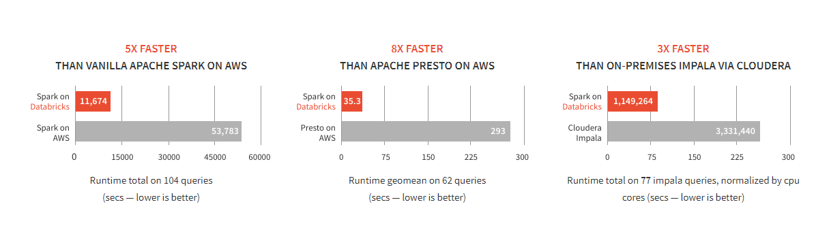
Databricks Spark is fast
Benchmarks have shown Databricks to often have better performance than alternatives
SOURCE: Benchmarking Big Data SQL Platforms in the Cloud

Slide 20

Azure Databricks
  Azure Databricks is a first party service on Azure.
    Unlike with other clouds, it is not an Azure Marketplace or a 3rd party hosted service.
  Azure Databricks is integrated seamlessly with Azure services:
    Azure Portal: Service an be launched directly from Azure Portal
    Azure Storage Services: Directly access data in Azure Blob Storage and Azure Data Lake Store
    Azure Active Directory: For user authentication, eliminating the need to maintain two separate sets of uses in Databricks and Azure.
    Azure SQL DW and Azure Cosmos DB: Enables you to combine structured and unstructured data for analytics
    Apache Kafka for HDInsight: Enables you to use Kafka as a streaming data source or sink
    Azure Event Hub & Azure IOT Hubs: Enables you to use Event Hub and IOT Hub as a streaming data source
    Azure Billing: You get a single bill from Azure
    Azure Power BI: For rich data visualization
    Azure Data Factory: For ETL/ELT
Microsoft Azure

Slide 21
Use cases

Slide 22

Big Data & Advanced Analytics at a glance
Ingest
Store
Prep & Train
Model & Serve
Intelligence
Business
apps
Data Factory
(Data movement, pipelines & orchestration)
Cosmos DB
Predictive apps
Blobs
Data Lake
Databricks
HDInsight
Data Lake Analytics
SQL
Custom
apps
Kafka
10
01
SQL Database
SQL Data Warehouse
Operational reports
Event Hub
IoT Hub
Machine Learning
Sensors
and devices
Analysis Services
Analytical dashboards

Slide 23
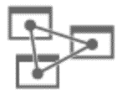
Data Engineering - Modern DW for BI
Ingest
Store
Prep & Train
Model & Serve
Intelligence
Logs, files and media
(unstructured)
Data factory
Azure storage
Azure Databricks
(Spark)
On Prem, Cloud
Apps & Data
Azure Analysis Services
Analytical dashboards
(PowerBI)
Polybase
Business / custom apps
(Structured)
Data factory
Azure SQL Data Warehouse
AZURE DATA FACTORY ORCHESTRATES DATA PIPELINE ACTIVITY WORKFLOW & SCHEDULING

Slide 24
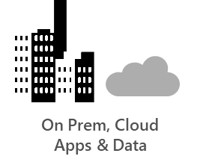

Data engineering - Modern DW for SaaS Apps
Ingest
Store
Prep & Train
Model & Serve
Intelligence
Logs, files and media
(unstructured)
Azure Databricks
(Spark)
Data factory
Azure storage
CosmosDB
Polybase
Business / custom apps
(Structured)
Data factory
SaaS App
Browser/Device
AZURE DATA FACTORY ORCHESTRATES DATA PIPELINE ACTIVITY WORKFLOW & SCHEDULING

